Slide 1
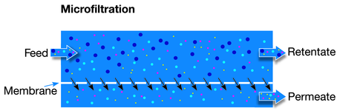
MICRO FILTRATION MEMBRANE FROM COAL FLY ASH
JOURNAL OF HAZARDOUS MATERIAL
DESIGN CREDIT UNDER VIKKY ANAND

Slide 2
INTRODUCTION
Ceramic membranes are used in cross-flow filtration method
Alumina, Zirconia, Titania, and Silica are primary materials for membrane preparation.
Efficient membranes- APATITE, CLAYS
Mineral coal fly ash could also be a good material for membrane preparation.
Some civil engineers research using COAL ASH for manufacturing, which leads us to use it for membrane material.

Slide 3
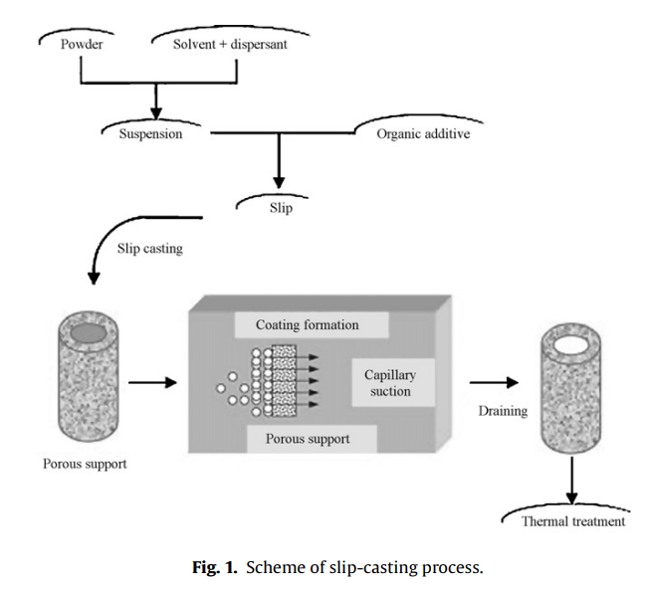
SLIP CASTING PROCESS
Slip casting is a ceramic forming technique. It involves pouring or pumping a liquid clay body slip into plaster moulds . The plaster absorbs the water from the slip, leaving a thin layer of clay on the inside walls of the mould.

Slide 4
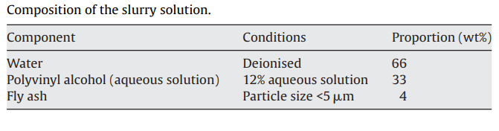
MATERIALS AND METHOD
CHARACTERISATION OF THE FLY ASH POWDER
Fly ash powder is obtained through CALCINATION PROCESS.
Particle size analysis is done through ACCUSIZER MODEL.
SEM(scanning electron microscope) use to study powder morphology.
MEMBRANE ELABORATION
The microfiltration layer comprises the solution containing the powder and an aqueous solution of polyvinyl alcohol(PVA).
The slip composition is optimised using a VISCOSIMETER.

Slide 5
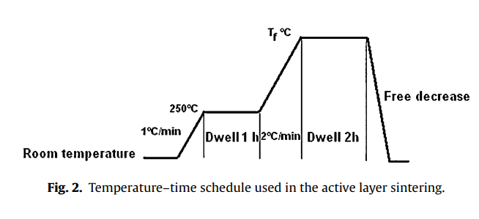
SINTERING PROGRAM
Firing temperature fixed at 800 C is reached .
For this temperature plate at 250 C is kept for 1hour to eliminate the PVA.
FILTRATION TEST
Before test the microfiltration membrane keep immersed in pure de-ionised water for 24 hours.
Test is conducted using a home made pilot plant.
Transmembrane pressure is maintained using adjustable valve.
The membrane total active area is 20.4cm2.
The water flux through membrane is measured as a function of time at different transmembrane pressure .

Slide 6
RESULT AND CONCLUSION
FLY ASH CHARACTERISATION
Chemical composition
Thermal analysis
Mass loss is around 1.5% which is due to some impurities or absorbed water and small percentage of unburned mineral coal powder.
3. Phase identification
A minority of anhydrites is visible on the spectrum. The origin of mineral coal fly ash is due to particles of clay dispersed in the coal rock.
ELEMENTS | Wt%
SiO2 | 49.09
Al2O3 | 24.34
Fe2O3 | 8.93
CaO | 4.88
MgO | 3.15
K2O | 1.74
SO3 | 2.15
LOIa | 1.07

Slide 7
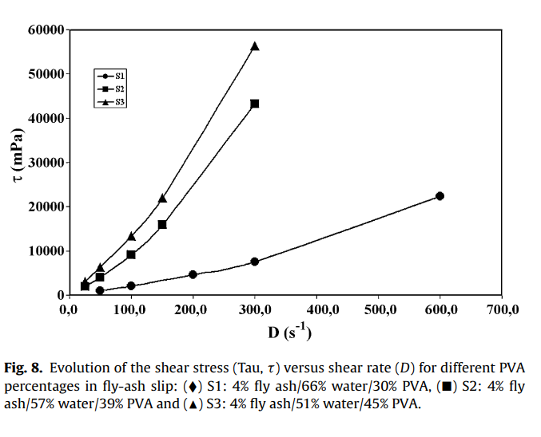
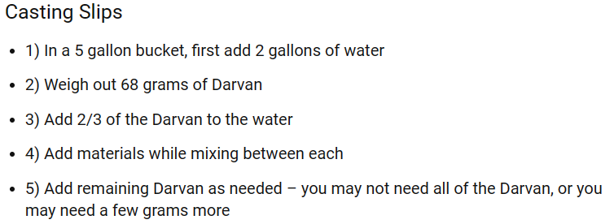
MEMBRANE CHARACTERISATION
Three slips with 4% fly ash PVA(30%, 39%, 45%) prepared.
Slip s1 and s2 were used to prepare an active layer on the microporous support.
Porosity and pore size distribution were measured by mercury porosimetry.
MERCURY POROSIMETRY- penetration of mercury into membrane’s pores under pressure.
The membrane permeability can be measured using the variation of the water flux with transmembrane pressure following the Darcy’s Law.

Slide 8
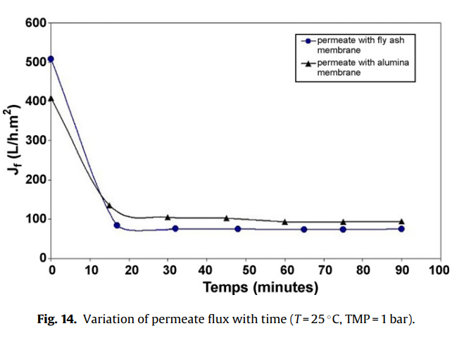
APPLICATION TO THE TREATMENT OF TEXTILE DYE WASTE WATER
Two microfiltration membrane one is alumina membrane and fly ash membrane is used.
Microfiltration using fly-ash membrane proved to be effective in removing the COD, turbidity.
The effluent quality before and after microfiltration shown in the table.
SAMPLE | CONDUCTIVITY(US cm−1) | TURBIDITY (NTU) | COD (mg L−1) | ABSORBANCE (at 600nm)
Raw effluent | 6.16 | 45.5 | 3440 | 0.104
Fly ash membrane permeate | 5.38 | 0.58 | 880 | 0.010
Alumina membrane permeate | 5.64 | 0.62 | 834 | 0.013

Slide 9
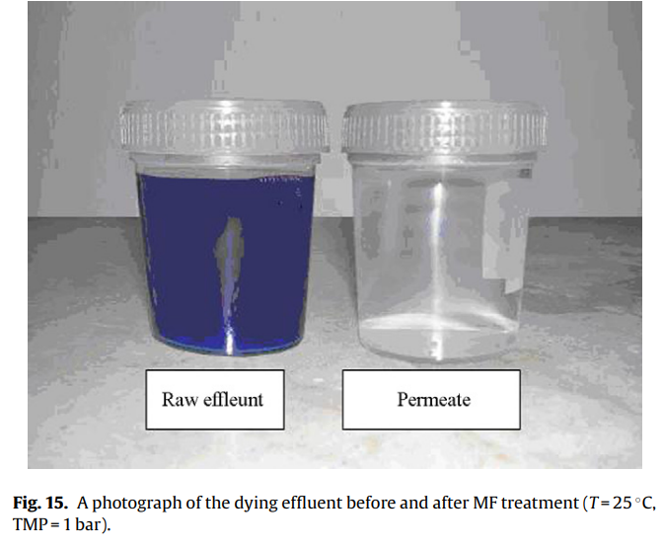
CONCLUSION
New ceramic microfiltration membranes were successfully prepared using mineral coal fly ash and characterized for their properties.
Permeate quality was also comparable between the two membranes: Chemical Oxygen Demand (COD) removal efficiency was 75%, and color removal efficiency was 9%.
The experimental outcomes strongly suggest that mineral coal fly ash is a suitable material for developing microfiltration membranes, offering potential applications in industrial wastewater treatment.

Slide 10
THANKS

